Slide 1
skip list

Slide 2
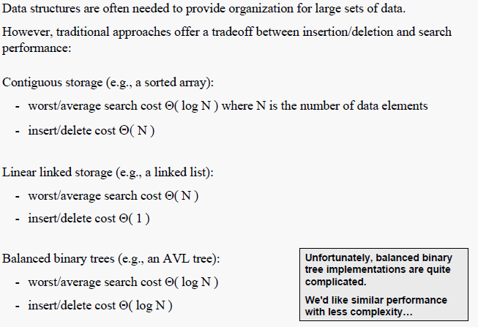
Skip List Motivation

Slide 3
Skip List
Skip lists were invented in 1990 by William Pugh.
This data structure makes random choices in arranging the entries in such a way that search and update times are O(logn) on average, where n is the number of entries in the dictionary.
A skip list is a linked list sorted by keys. Each node is assigned a random height, up to some maximum. The number of nodes at any height decreases exponentially with that height.
A skip list node has one successor at each level of height.
For example, a node of height 3 has three next pointers, one to the next node of height 1, and another to the next node at height 2, and so on.

Slide 4
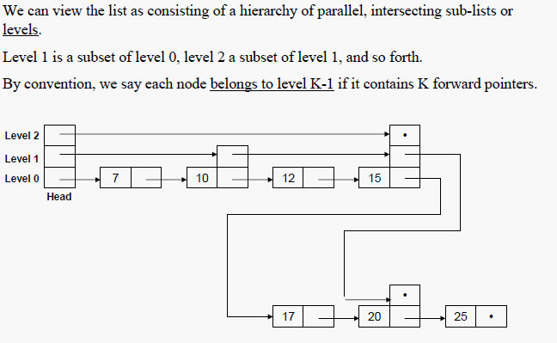
Skip List

Slide 5
Skip List
Skip lists are made up of a series of nodes connected one after the other. Each node contains a key/value pair as well as one or more references, or pointers, to nodes further along in the list.
The number of references each node contains is determined randomly. This gives skip lists their probabilistic nature, and the number of references a node contains is called its node level.
Two nodes that are always present in a skip list are the header node and the NIL node.

Slide 6
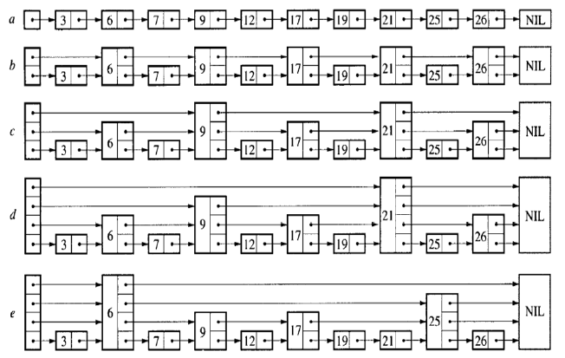
Examples

Slide 7
Searching in Skip List
Searching for a key within a skip list begins with starting at header at the overall list level and moving forward in the list comparing node keys to the search key.
If the node key is less than the search key, the search continues moving forward at the same level.
If on the other hand, the node key is equal to or greater than the search key, the search drops down one level and continues forward.

Slide 8
Continuation
This process continues until the search key has been found if it is present in the skip list.
If it is not, the search will either continue to the end of the list or until the first key with a value greater than the search key is found.

Slide 9
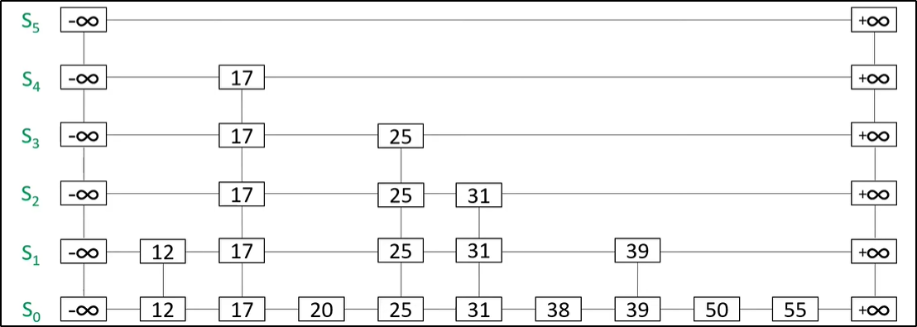
Example
Consider given skip list

Slide 10
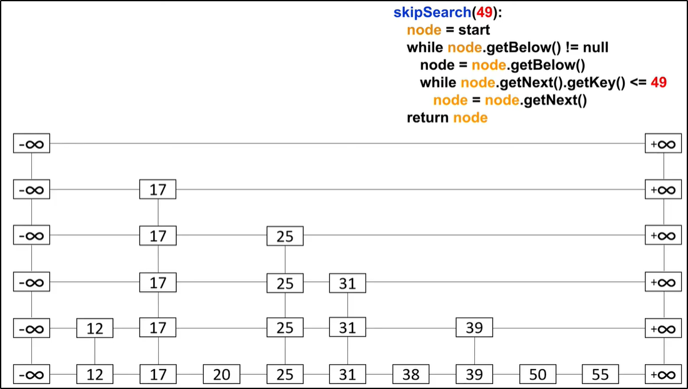
Search 49

Slide 11
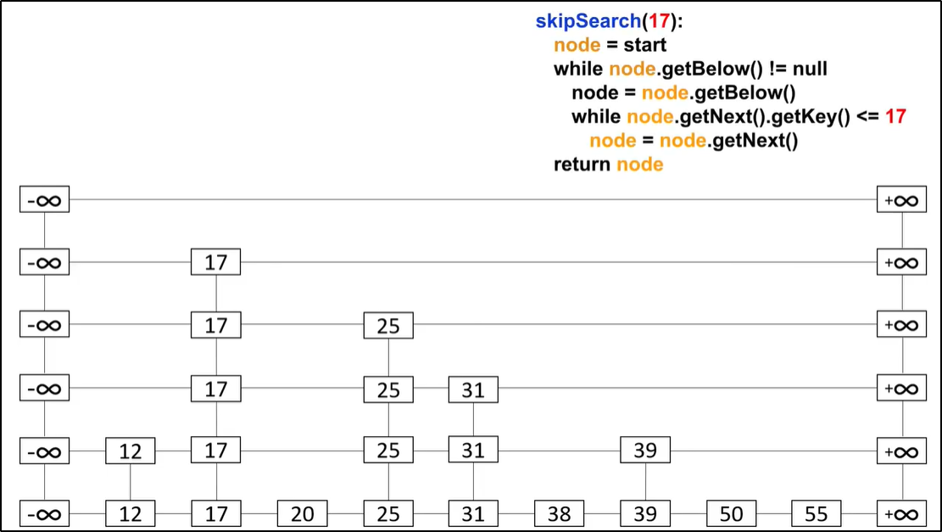
Search 17

Slide 12
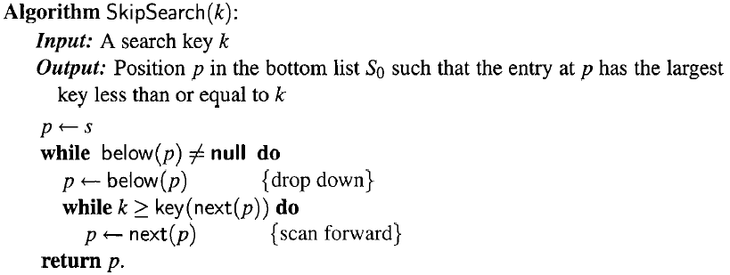
Algorithm of Searching

Slide 13
Complexity in Searching
To search for an element with a given key
Find location in top list. Top list has O(1) elements with high probability. Location in this list defines a range of items in next list. Drop down a level and recurse
O(1) time per level on average
O(log n) levels with high probability
Total time: O(log n)

Slide 14
Insertion in Skip List
Insertion begins with a search for the place in the skip list to insert the new key/value pair.
The search algorithm is used preceding Node key of the new key to insert in skip list
This is done because the pointers in those nodes will need to be rearranged when the new node is inserted into the skip list.

Slide 15
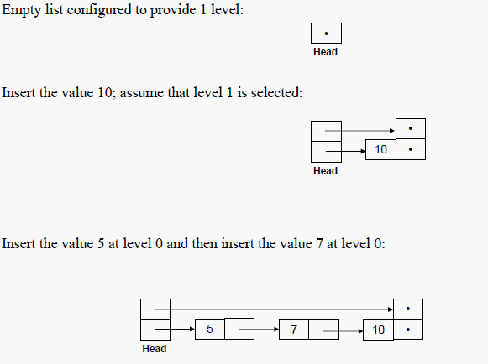
Example

Slide 16
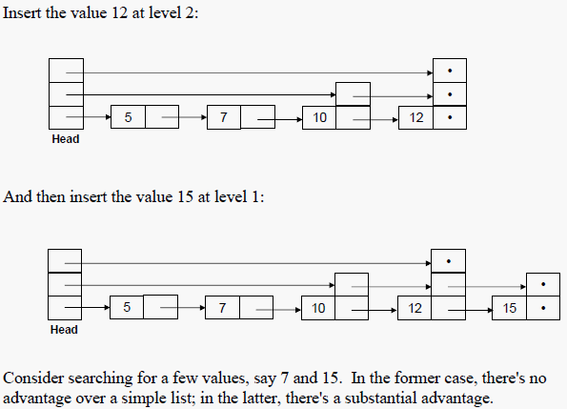
Cont..

Slide 17
Insert new node in skip list
Add 42 in the List at level 0
42

Slide 18
Updating pointer during insertion
Add 36 in the List at level 2
36
36
36

Slide 19
Complexity
Do a search for that key
Insert element in bottom-level list
With probability p, recurse to insert in next level
Expected number of lists = 1+ p + p2 + … = 1/ (1-p) = O(1)
if p is constant
Total time = Search + O(1) = O(log n) expected
Skip list delete: O(1)

Slide 20
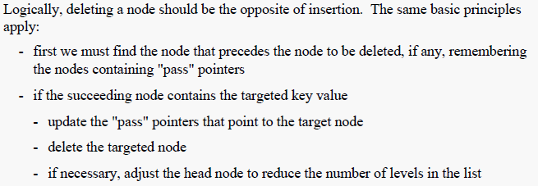
Deletion in skip list

Slide 21
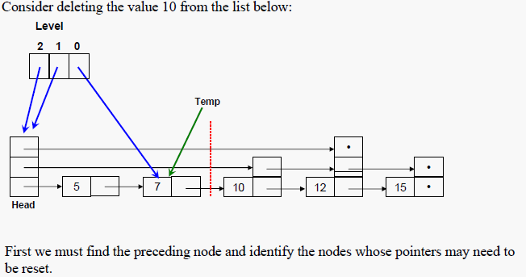
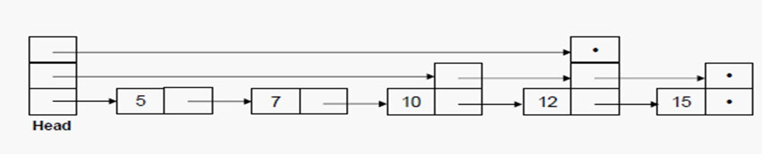
Example

Slide 22
Delete 25 from the Skip List

Slide 23
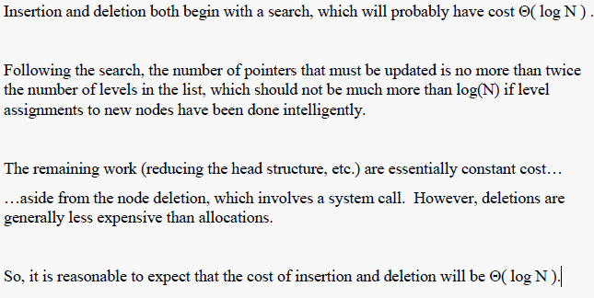
Insertion/Deletion Performance

Slide 24
Applications in some fields
Q-Map - The QMap class is a value-based template class that provides a dictionary
Skip DB - It is an open-source database format using ordered key/value pairs

